Slide 1
CSE231Digital Logic
Prof. Dr. Muhammad Shahin Uddin
Email: shahin.Uddin@mbstu.ac.bd

Slide 2
Karnaugh Maps - Rules of Simplification : Summary
No zeros allowed.
No diagonals.
Only power of 2 number of cells in each group.
Groups should be as large as possible.
Every one must be in at least one group.
Overlapping allowed.
Wrap around allowed.
Fewest number of groups possible.

Slide 3
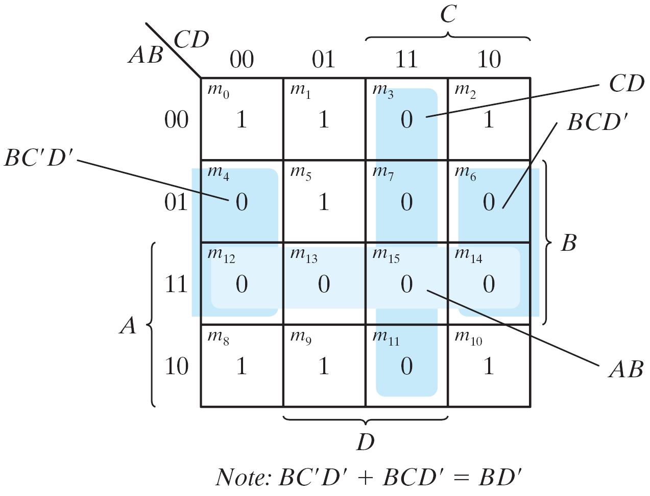
Example 1
Simplify F = ∑(0, 1, 2, 5, 8, 9, 10) into sum-of-products form
F(A, B, C, D)= Σ(0, 1, 2, 5, 8, 9, 10) = B'D'+B'C'+A'C'D

Slide 4
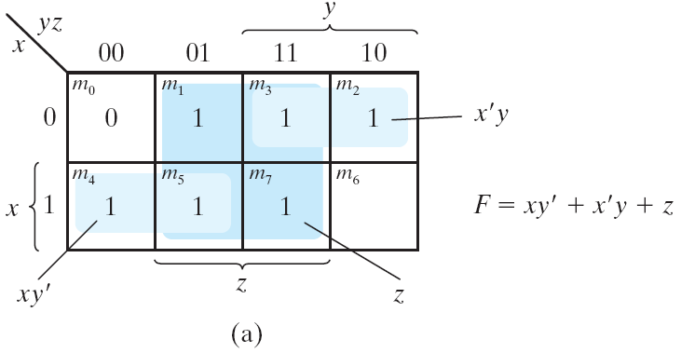
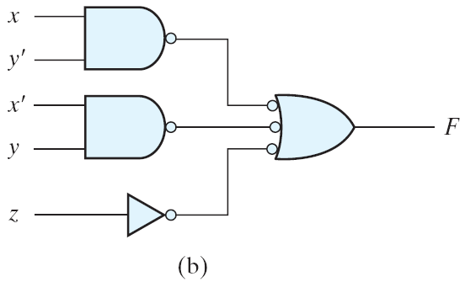
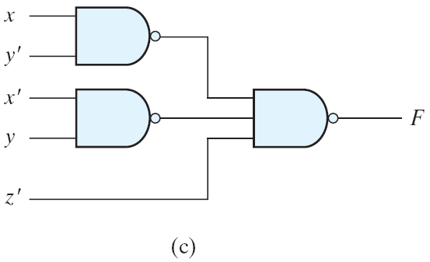
Example 2
Implement F(x, y, z) =
∑( 1, 2, 3, 4, 5, 7)
Solution to Example10

Slide 5
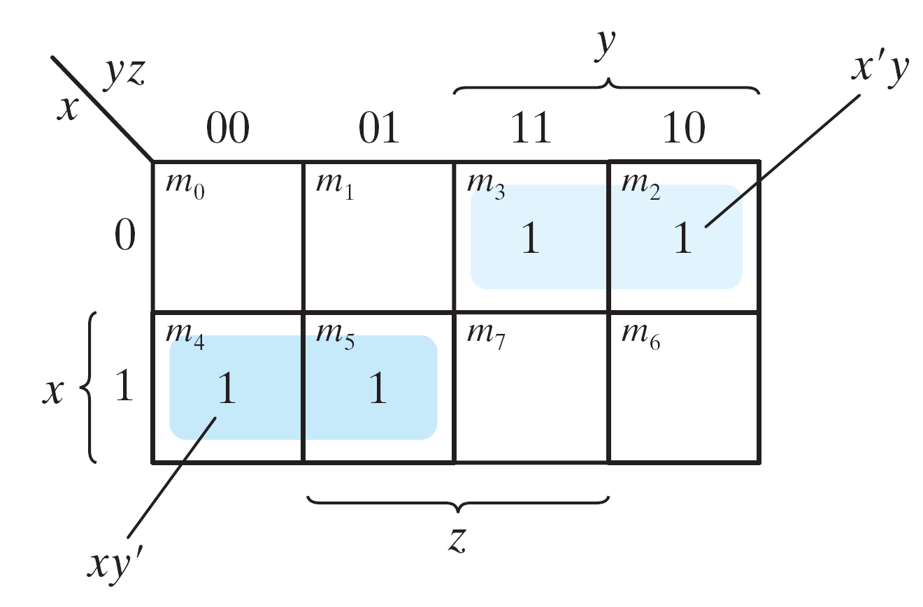
Example 3
Simplify the Boolean function F(x, y, z) = ∑(2, 3, 4, 5)
F(x, y, z) = ∑(2, 3, 4, 5) = x'y + xy'
F(x, y, z) = Σ(2, 3, 4, 5) = x'y + xy'

Slide 6
Example 4
Simplify F(x, y, z) = ∑(3, 4, 6, 7)
F(x, y, z) = ∑(3, 4, 6, 7) = yz+ xz'
F(x, y, z) =x’yz+xy’z’+xyz’+xyz
=x’yz+xz’(y’+y)+xyz
=x’yz+xz’+xyz
=yz(x’+x)+xz’
=yz+xz’
F(x, y, z) = Σ(3, 4, 6, 7) = yz + xz'

Slide 7
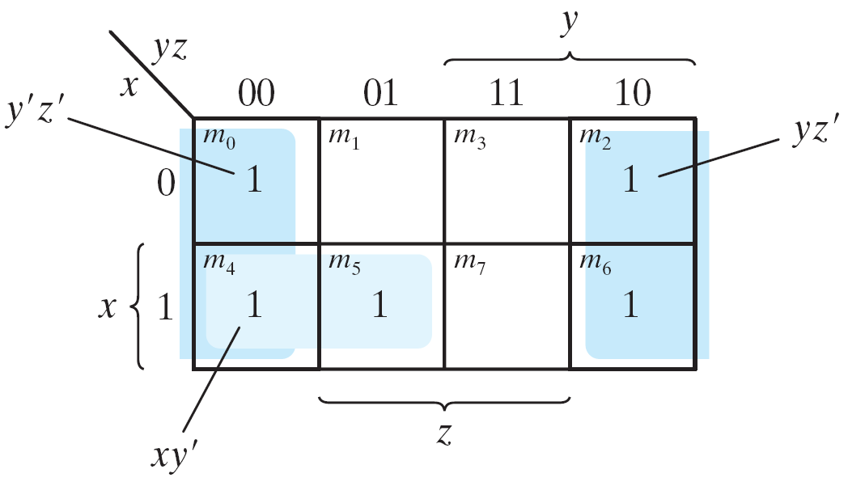
Example 5
Simplify F(x, y, z) = ∑(0, 2, 4, 5, 6)
F(x, y, z) = ∑(0, 2, 4, 5, 6) = z'+ xy'
F(x, y, z) = Σ(0, 2, 4, 5, 6) = z' +xy'

Slide 8
Example 6
Implement F(x, y, z) =
∑( 1, 2, 3, 4, 5, 7)
Solution to Example10

Slide 9
Example 7
F = A'C + A'B + AB'C + BC
Express it in sum of minterms.
Find the minimal sum of products expression.
F(A, B, C) = ∑(1, 2, 3, 5, 7) = C + A'B
F(A, B, C) = C + A'B

Slide 10
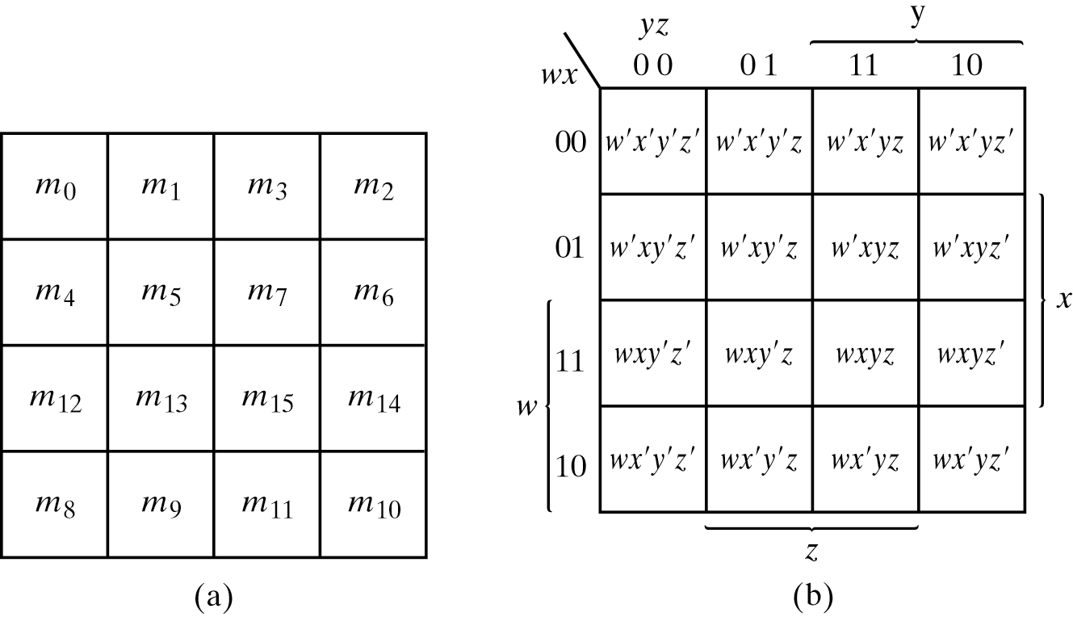
Four-Variable Map
The map
16 minterms
Combinations of 2, 4, 8, and 16 adjacent squares
Four-variable Map

Slide 11
Problem-08: Minimize the following boolean function- F(A, B, C, D) = Σm(0, 1, 3, 5, 7, 8, 9, 11, 13, 15)

Slide 12
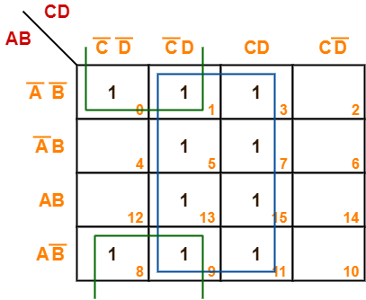
Problem-09: Minimize the following boolean function- F(A, B, C, D) = Σm(0, 1, 3, 5, 7, 8, 9, 11, 13, 15)
F(A, B, C, D) = B’C’ + D

Slide 13
Example 10
Simplify F(w, x, y, z) = S(0, 1, 2, 4, 5, 6, 8, 9, 12, 13, 14)
F = y'+w'z'+xz'
F(w, x, y, z) = Σ(0, 1, 2, 4, 5, 6, 8, 9, 12, 13, 14) = y' + w' z' +xz'

Slide 14
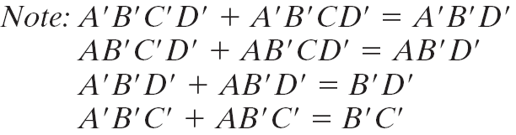
Example11
Simplify F = A′B′C′ + B′CD′ + A ′ BCD ′ + AB′C′
A′B′C′ + B′CD′ + A′B′C′D′ + AB′C′= B′D′ + B′C′ +A′CD′

Slide 15
Example 12
Simplify F = ∑(0, 1, 2, 5, 8, 9, 10) into sum-of-products form
F(A, B, C, D)= Σ(0, 1, 2, 5, 8, 9, 10) = B'D'+B'C'+A'C'D

Slide 16
Problem-13: Minimize the following Boolean function- F(A, B, C, D) = Σm(0, 1, 2, 5, 7, 8, 9, 10, 13, 15)

Slide 17
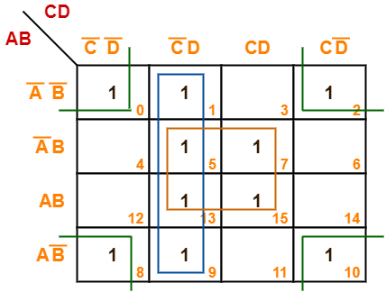
Now, F(A, B, C, D) = (A’B + AB)(C’D + CD) + (A’B’ + A’B + AB + AB’)C’D + (A’B’ + AB’)(C’D’ + CD’) = BD + C’D + B’D’ Thus, minimized Boolean expression is- F(A, B, C, D) = BD + C’D + B’D’

Slide 18
Don't-Care Conditions
The value of a function is not specified for certain combinations of variables
The don't-care conditions can be utilized in logic minimization
Can be implemented as 0 or 1

Slide 19
Problem-14: Minimize the following boolean function- F(A, B, C, D) = Σm(1, 3, 4, 6, 8, 9, 11, 13, 15) + Σd(0, 2, 14)

Slide 20
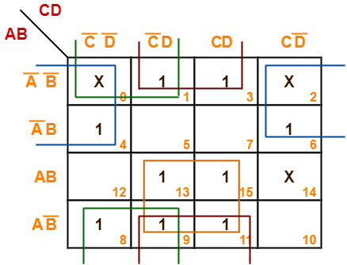
Problem-14: Minimize the following boolean function- F(A, B, C, D) = Σm(1, 3, 4, 6, 8, 9, 11, 13, 15) + Σd(0, 2, 14)
F(A, B, C, D) = AD + B’D + B’C’ + A’D’

Slide 21
Example 15
Simplify F(w, x, y, z) = ∑(1, 3, 7, 11, 15) which has the don't-care conditions d(w, x, y, z) = ∑(0, 2, 5).
F = yz + w'x'; F = yz + w'z
F = ∑(0, 1, 2, 3, 7, 11, 15) ; F = ∑(1, 3, 5, 7, 11, 15)
Either expression is acceptable
Example with don't-care Conditions

Slide 22
Karnaugh Maps – Practice
Some Selected Problems
16. Minimize the following boolean function-F(A, B, C) = Σm(1, 2, 5, 7) + Σd(0, 4, 6)
17 Minimize the following boolean function-F(A, B, C) = Σm(0, 1, 6, 7) + Σd(3, 4, 5)
18. Minimize the following boolean function-F(A, B, C, D) = Σm(0, 2, 8, 10, 14) + Σd(5, 15)
19. Consider the following boolean function- F(W, X, Y, Z) = Σm(1, 3, 4, 6, 9, 11, 12, 14)

Slide 23
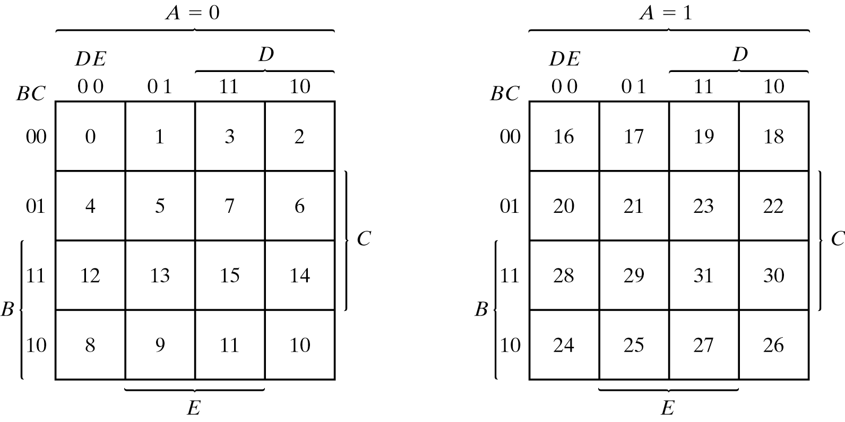
Five-Variable Map
Map for more than four variables becomes complicated
Five-variable map: two four-variable map (one on the top of the other).
Five-variable Map

Slide 24
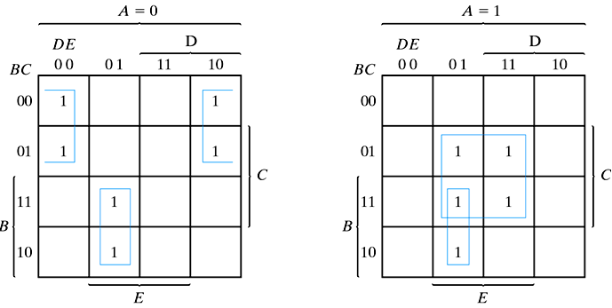
Example 20
Simplify F = ∑(0, 2, 4, 6, 9, 13, 21, 23, 25, 29, 31)
F = A'B'E'+BD'E+ACE

Slide 25
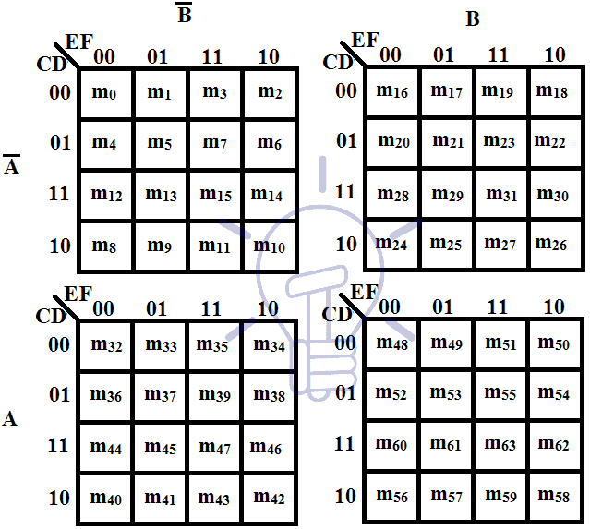
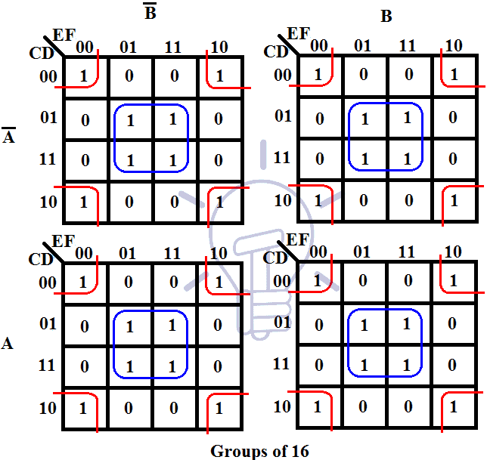
K-Map: Six-Variables
6-variable k-map is a complex k-map which can be drawn.
Visualizing 6-variable k-map is a little bit tricky.
6 variables make 64 min terms, this means that the k-map of 6 variables will have 64 cells.
Its geometry becomes difficult to draw as these cells are adjacent to each other in all direction in 3-dimensions i.e. a cell is adjacent to upper, lower, left, right, front and back cells at the same time.
we will draw it like 5-variable k-map as shown in the figure below.

Slide 26
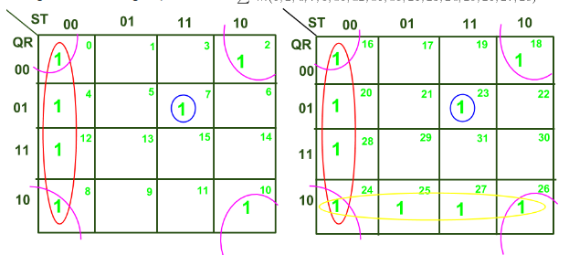
Solving SOP function: For clear understanding, let us solve the example of SOP function minimization of 5 Variable K-Map using the following expression
:

Slide 27
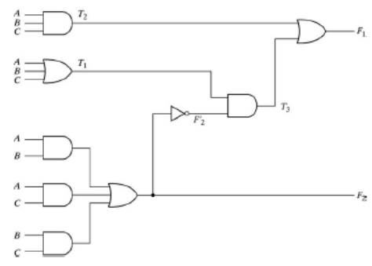
Design Procedure
Design Procedure:
Input: the specification of the problem
Output : the logic circuit diagram (or Boolean function)
Step1: determine the required number of inputs and outputs from the specification
Step2: derive the truth table that defines the required relationship between inputs and outputs
Step3: obtain the simplified Boolean function for each output as a function of the input variables
Step4: draw the logic diagram and verify the correctness of the design

Slide 28
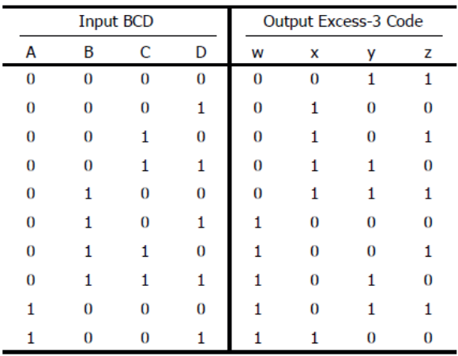
Design of BCD to Excess -3 Code Converter Circuit
Convert from BCD code to Excess-3 code
The 6 input combinations not listed are don’t cares
These values have no meaning in BCD
We can arbitrary assign them to 1 or 0
BCD to Excess-3 Code
0 0 0 1 =1
0 0 1 1 =3
0 1 0 0 =4
+

Slide 29
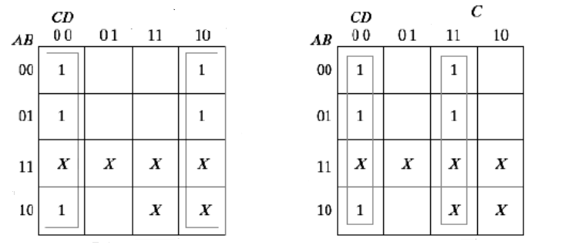
Maps for Code Conversion…. Example
The six don’t care minterms (10-15) are marked with x
z=D’
y=CD+C’D’

Slide 30
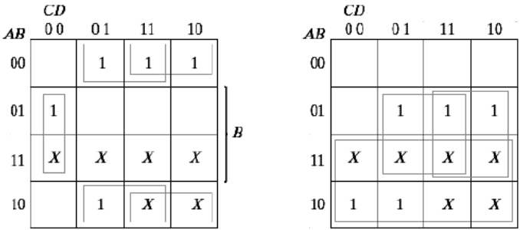
Maps for Code Conversion…. Example
x=B’C+B’D+BC’D’
w=A+BC+BD

Slide 31
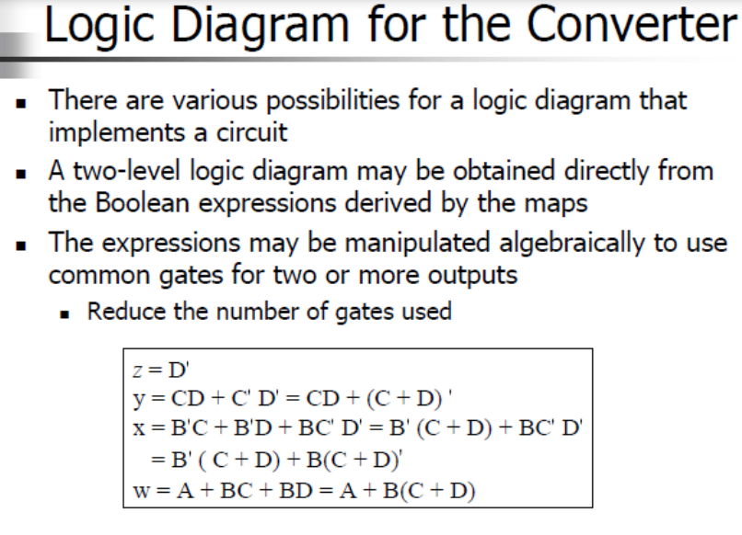
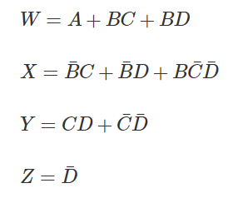
Logic Diagram for the Converter
There are various possibilities for a logic diagram that implements a circuit
A two-level logic diagram may be obtained directly from the Boolean expressions derived by the maps
The expressions may be manipulated algebraically to use common gates for two or more outputs
Reduce the number of gates used

Slide 32
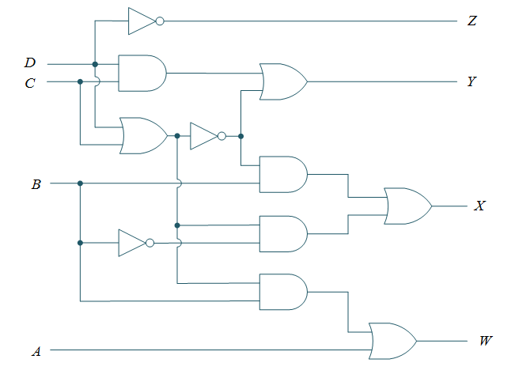
Logic Diagram for the Converter
D’
CD
(C+D)’
C+D

Slide 33
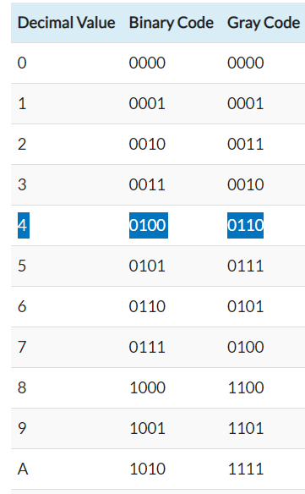
Design of BCD to Gray Code Converter Circuit
Convert from BCD (0-9) code to Gray code
The 6 input combinations not listed are don’t cares
We can arbitrary assign them to 1 or 0 (don’t care)
BCD to Gray Code
BCD 0 0 0 1 = Gray

Slide 34
Application of Combinational Circuit

Slide 35
Parity Bit:
The parity generating technique is one of the most widely used error detection techniques for the data transmission.
In digital systems, when binary data is transmitted and processed, data may be subjected to noise so that such noise can alter 0s (of data bits) to 1s and 1s to 0s.
Hence, parity bit is added to the word containing data in order to make number of 1’s either even or odd.
Parity Generator
A parity generator is a combinational logic circuit that generates the parity bit in the transmitter
On the other hand, a circuit that checks the parity in the receiver is called parity checker

Slide 36
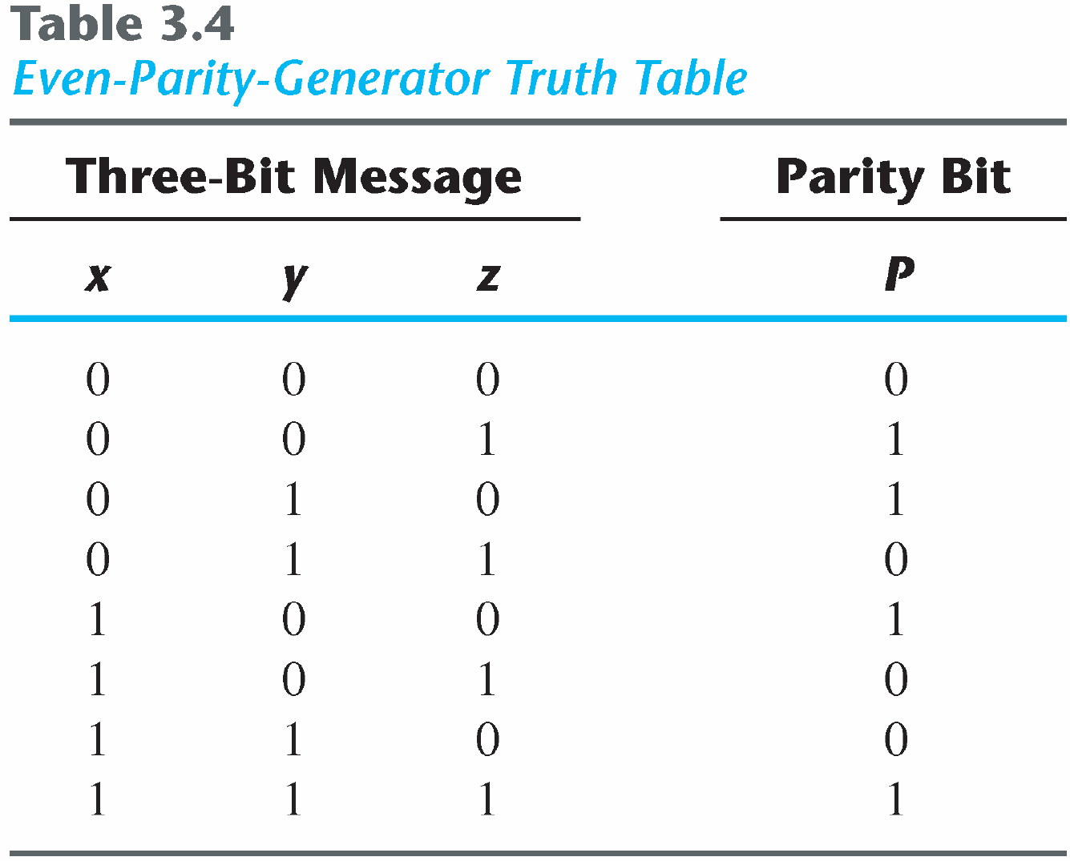
Parity Generation and Checking

Slide 37
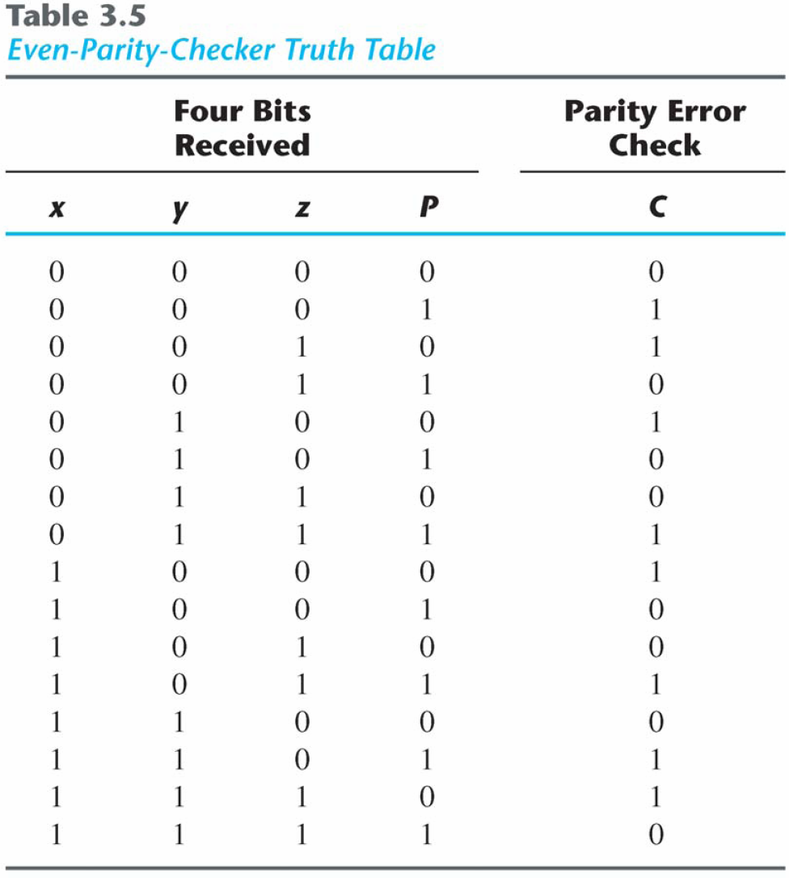
Parity Generation and Checking

Slide 38
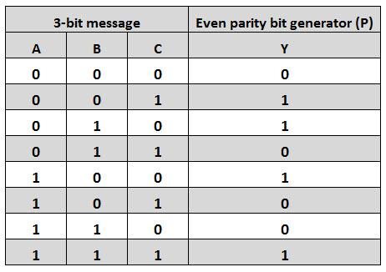
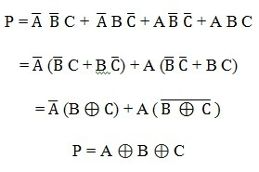
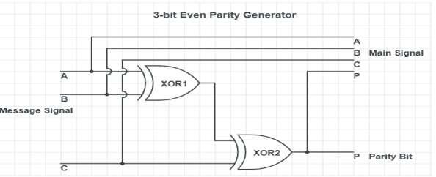
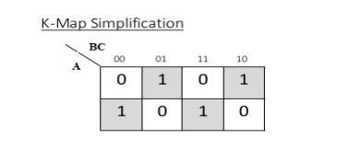
Even Parity Generator
From the above truth table, the simplified expression of the parity bit can be written as
K-map simplification for 3-bit message even parity generator is
0
1

Slide 39
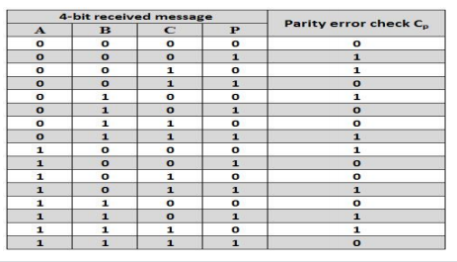
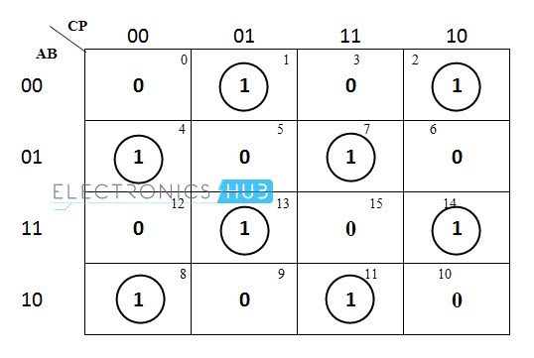
Even Parity Checker
The below table shows the truth table for the even parity checker :
PEC = 1 if the error occurs, i.e., the four bits received have odd number of 1s and
PEC = 0 if no error occurs, i.e., if the 4-bit message has even number of 1s.

Slide 40
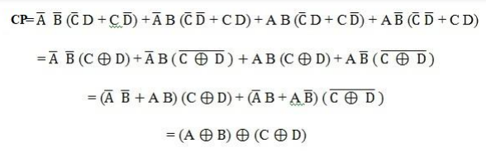
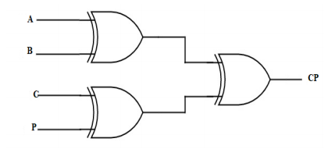
Even Parity Checker
The above logic expression for the even parity checker can be implemented by using three Ex-OR gates as shown in figure. If the received message consists of five bits, then one more Ex-OR gate is required for the even parity checking.

Slide 41
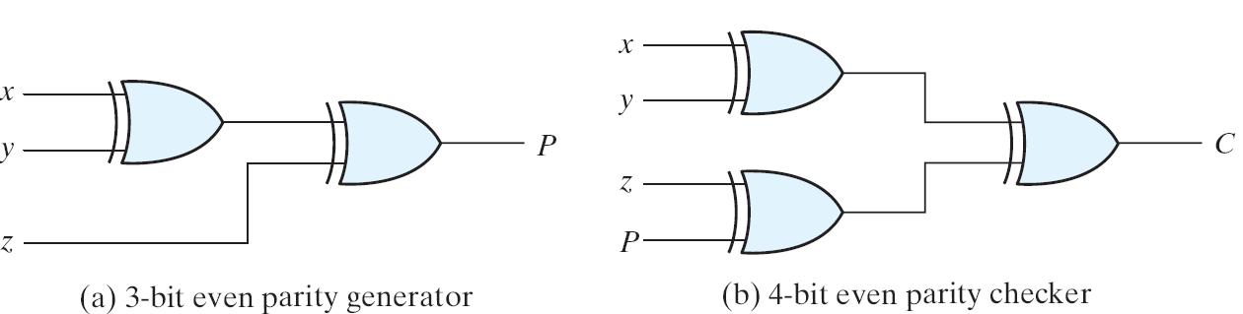
Parity Generation and Checking
Parity Generation and Checking
A parity bit: P = x⊕y⊕z
Parity check: C = x⊕y⊕z⊕P
C=1: one bit error or an odd number of data bit error
C=0: correct or an even # of data bit error
Logic Diagram of a Parity Generator and Checker

Slide 42
Even Parity Checker
The above logic expression for the even parity checker can be implemented by using three Ex-OR gates as shown in figure. If the received message consists of five bits, then one more Ex-OR gate is required for the even parity checking.

Slide 43
Application of Combinational Circuit

Slide 44
Encoders
Put “Information” into code
Binary Encoder
Example: 4-to-2 Binary Encoder
Only one switch should be activated at a time
0
Binary Encoder
x₀
x₁
x₂
x₃
x₃ x₂ x₁ | y₁ y₀
0 0 0 | 0 0
0 0 1 | 0 1
0 1 0 | 1 0
1 0 0 | 1 1
1
y₁
y₀
2
3

Slide 45
Encoders
Octal-to-Binary Encoder (8-to-3)
Binary Encoder
I₇
I₆
I₅
I₄ I₃
I₂
I₁
I₀
I₇ I₆ I₅ I₄ I₃ I₂ I₁ I₀ | Y₂ Y₁ Y₀
0 0 0 0 0 0 0 1 | 0 0 0
0 0 0 0 0 0 1 0 | 0 0 1
0 0 0 0 0 1 0 0 | 0 1 0
0 0 0 0 1 0 0 0 | 0 1 1
0 0 0 1 0 0 0 0 | 1 0 0
0 0 1 0 0 0 0 0 | 1 0 1
0 1 0 0 0 0 0 0 | 1 1 0
1 0 0 0 0 0 0 0 | 1 1 1
Y₂
Y₁
Y₀

Slide 46
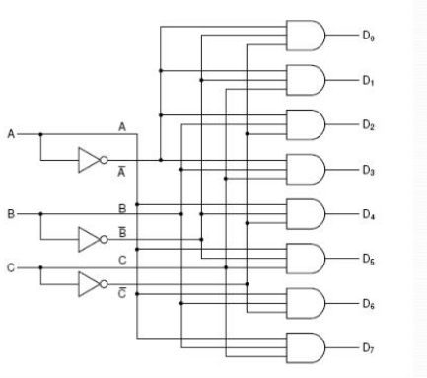
Decoder Circuit
A decoder is a circuit which takes an n-bits as input and use it to select (set to 1)exactly one of its 2^{n} outputs.

Slide 47
Decoders
Only one lamp will turn on
Extract “Information” from the code
Binary Decoder
Example: 2-bit Binary Number
x₁ | x₀ | O/P
0 | 0 | 0
0
1
2
3
Binary Decoder
1
0
0
0
x₁
x₀
0
0

Slide 48
Decoders
Only one lamp will turn on
Extract “Information” from the code
Binary Decoder
Example: 2-bit Binary Number
x₁ | x₀ | O/P
0 | 0 | 0
0 | 1 | 1
0
1
2
3
Binary Decoder
0
1
0
0
x₁
x₀
0
1

Slide 49
Decoders
Only one lamp will turn on
Extract “Information” from the code
Binary Decoder
Example: 2-bit Binary Number
x₁ | x₀ | O/P
0 | 0 | 0
0 | 1 | 1
1 | 0 | 2
0
1
2
3
Binary Decoder
0
0
1
0
x₁
x₀
1
0

Slide 50
Decoders
Only one lamp will turn on
Extract “Information” from the code
Binary Decoder
Example: 2-bit Binary Number
x₁ | x₀ | O/P
0 | 0 | 0
0 | 1 | 1
1 | 0 | 2
1 | 1 | 3
0
1
2
3
Binary Decoder
0
0
0
1
x₁
x₀
1
1

Slide 51
What is a Multiplexer (MUX)?
A MUX is a digital switch that has multiple inputs (sources) and a single output (destination).
The select lines determine which input is connected to the output.
MUX Types
→ 2-to-1 (1 select line)
→ 4-to-1 (2 select lines)
→ 8-to-1 (3 select lines)
→ 16-to-1 (4 select lines)
Multiplexer
Block Diagram
2^{N}
1
Inputs
(sources)
MUX
Output
(destination)
N
Select
Lines

Slide 52


Typical Application of a MUX
Multiple Sources
Selector
Single Destination
MP3 Player
Docking Station
D0
D1
D2
D3
Laptop
Sound Card
MUX
Y
Surround Sound System
Digital
Satellite
B | A | Selected Source
0 | 0 | MP3
0 | 1 | Laptop
1 | 0 | Satellite
1 | 1 | Cable TV
Digital
Cable TV
Notes:
This slide shows a typical application of a multiplexer (in this case a 4-to-1 MUX). Have the students share other common applications of MUXs.
http://images.tigerdirect.ca/skuimages/large/Logitech-X-540-L23-7250-mai.jpg

Slide 53
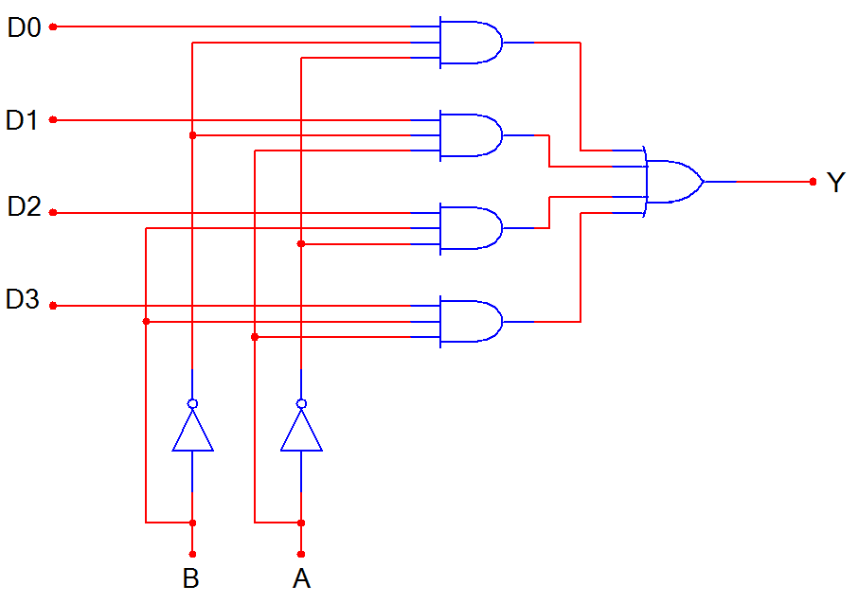
4-to-1 Multiplexer (MUX)
D0
D1
D2
D3
MUX
Y
B A
B | A | Y
0 | 0 | D0
0 | 1 | D1
1 | 0 | D2
1 | 1 | D3
Notes:
SSI logic diagram, block diagram, and truth table for a 4-to-1 MUX

Slide 54
4-to-1 Multiplexer Waveforms
D0
D1
D2
D3
A
B
Y
 | D0 | D1 | D2 | D3 | D0 | D1 | D2 | D3
Input
Data
Select
Line
Output
Data
Notes:
Waveform diagram for a 4-to-1 MUX. The input data signals (D0-D3) are colored RED to indicate when its is connected to the output Y. Note: There is no significance to the values of the four input data signals; they are intended solely to demonstrate that the select lines (A & B) will select what input data signal will be connected to the output.

Slide 55
Implementation of Boolean function using multiplexer
Type #1
Let us solve some problems on implementing the Boolean expressions using a multiplexer.
In this method, 3 variables are given(say P, Q, R), which are the selection inputs for the mux.
For three selection inputs, the mux to be built was 2^{n} = 2³ = 8 : 1.
So, in this method, the type of mux can be decided by the given number of variables.
How to solve?
The first step is to select the multiplexer. If the given expression has n variables, then determine the multiplexer using the formula 2^{n} : 1.
Connect the inputs, that correspond to the given minterms to logic 1.
Connect all the other inputs to the ground(logic 0).
Connect the input variables(P, Q, R) as the selection lines.
Solved example #1
Implement the Boolean expression F(A, B, C) = ∑ m(2, 3, 6, 7) using a multiplexer.

Slide 56
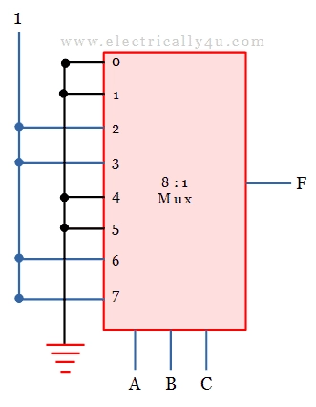
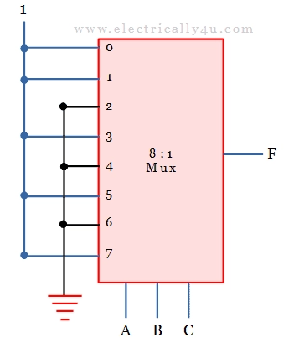
Solution:
There are 3 variables in the given expression, hence 2^{n} = 2³ = 8 : 1 multiplexer.
So, the mux has 8 input lines, 3 selection lines, and one output.
The inputs, corresponding to the minterms (2, 3, 6, 7) are connected to the logic 1 and remaining terms to the logic 0(grounded).
The given input variables are connected as three selection lines.
Example #2
Implement the Boolean expression F(A, B, C) = ∑ m(0, 1, 3, 5, 7) using a multiplexer.
Solution:
Similar to the above problem, there are 3 variables and hence 8 : 1 multiplier is used to solve the expression.
The three input variables(A, B, C) are connected as three selection lines.
The inputs, corresponding to the minterms (0, 1, 3, 5, 7) are connected to the logic 1 and remaining terms to the logic 0(grounded).

Slide 57
Implementation of Boolean Function in Multiplexer
Type #2
If the boolean expression has n+1 variables, we take only n variables as the selection line of the multiplexer.
The remaining single variable is used as the inputs of the mux.
In this way, any Boolean expression having n variables can be implemented with 2^{n-1} to 1 multiplexer.
How to solve?
From the given set of n+1 input variables, the n least significant variables are used as selection line inputs.
The 2^{n} inputs for 2^{n} : 1 multiplexer are derived by using an implementation table.
The implementation table has all the inputs(D₀, D₁, D₂, D₃,…) for the multiplexer, under which, all the minterms are listed in two rows.
The first row consists of all minters where A is complemented and the second row has the remaining minterms where A is in uncomplemented form.
The minterms in the given Boolean expression alone are circled.

Slide 58
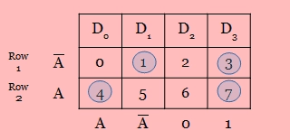
Look at the example of implementation table here,
Each column is analyzed separately as follows:
If both the minterms in the two rows are circled,
1 is applied to the corresponding multiplexer input.(check 4th column in the above table)
If both the minterms in the two rows are not circled, 0 is applied to the corresponding multiplexer input.(check 3rd column in the above table)
If the minterm in the first row alone is circled, is applied to the corresponding multiplexer input.(check 2nd column in the above table)
If the minterm in the second row alone is circled, is applied to the corresponding multiplexer input.(check 1st column in the above table)
Solved example #3 (Type#2)
Implement the boolean expression F(A, B, C) = ∑ m(0, 2, 5, 6) using 4 : 1 multiplexer.
Solution:
In the given Boolean expression, there are 3 variables.
We should use 2³ : 1 = 8 : 1 multiplexer. But as per the question, it is to be implemented with 4 : 1 mux.
For 4 : 1 multiplexer, there should be 2 selection lines.
So from the given 3 variables, the 2 least significant variables(B, C) are used as selection line inputs.

Slide 59
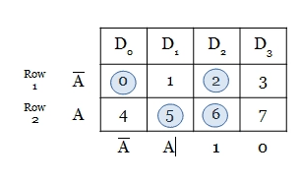
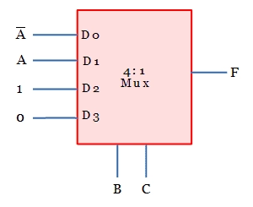
Let us derive the four inputs of 4 : 1 multiplexer using the implementation table.
The four inputs are listed in column-wise and all the minterms are written under the four inputs in 2 rows as shown below.
The minterms given in the boolean expression is circled and analyzed.
After analyzing, the input values of 4 : 1 mux is obtained as , A, 1, 0.
Thus the circuit can be drawn as below.

Slide 60
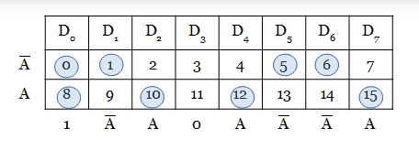
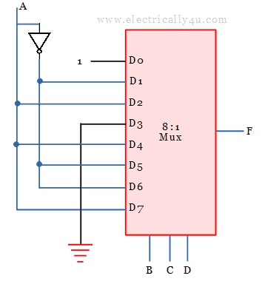
Solved example #4 (Type#2)
Implement F(A, B, C, D) = ∑ m(0, 1, 5, 6, 8, 10, 12, 15) using 8 : 1 multiplexer.
Solution:
In the given boolean expression, there are 4 variables.
We should use 2⁴ : 1 = 16 : 1 multiplexer.
But as per the question, it is to be implemented with 8 : 1 mux.
For 8 : 1 multiplexer, there should be 3 selection lines.
So from the given 4 variables, the 3 least significant variables(B, C, D) are used as selection line inputs.
From the derived input, 8 : 1 multiplexer can be drawn as below

Slide 61
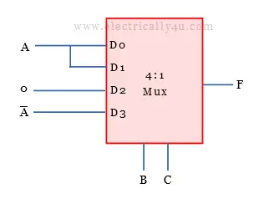
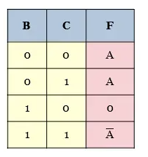
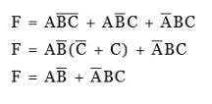
Example #5 For the given multiplexer circuit, determine the logic function.
Solution:
In the given multiplexer circuit, B and C are the selection inputs. Hence the possible input combinations are 00, 01, 10 and 11.
For these input combinations, the mux selects a particular input and gives it to the output.
That is, if BC input is 00, D₀ is selected as the output. Similarly if BC = 01, D₁ is selected as the output. When the input BC = 10, D₂ is selected as the output. If BC = 11, D₃ is selected as the output.

Slide 62
Example 6
Implement F(A, B, C, D) = ∑ m(2, 4, 6, 7, 9, 10, 11, 12, 15) using 8: 1 multiplexer.

Slide 63
Why Programmable Logic?
Facts:
It is most economical to produce an IC in large volumes
But:
Many situations require only small volumes of ICs
Many situations require changes to be done in the field, e.g. Firmware of a product under development
A programmable logic device can be:
Produced in large volumes
Programmed to implement many different low-volume designs

Slide 64
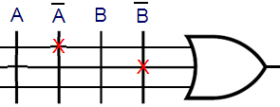
Programmable Logic - Additional Advantages
Many programmable logic devices are field-programmable, i. e., can be programmed in the field by the user - outside of the manufacturer’s environment
Nowadays, most programmable logic devices are erasable and reprogrammable (i.e. can programmed many times)
Allows “updating” a device or firmware, correction of errors
Allows reuse the device for a different design - re-usability!
Concept of
Logic Programming
Locations of connections
determine the logic function implemented

Slide 65
Hardware Programming Technologies
In the Factory - Cannot be erased/reprogrammed by user
Mask programming (changing the VLSI mask) during manufacturing
Programmable only once
Fuse
Anti-fuse
Reprogrammable (Erased & Programmed many times)
Volatile - Programming lost if chip power lost
Single-bit storage element
Non-Volatile - Programming survives power loss
UV Erasable
Electrically Erasable
Flash (as in Flash Memory)

Slide 66
PLDs: Basic Ideas
A PLD consists of an array of AND gates and an array of OR gates
Each input feeds both a non-inverting buffer and an inverting buffer to produce the true and inverted forms of each variable.
The AND outputs are called the product lines
Each product line is connected to one of the inputs of each OR gate
Three fundamental types of standard PLDs: PROM, PAL, and PLA

Slide 67
Basic Configuration of Three PLDs
Inputs
Fixed
Fixed
Programmable
Programmable
Connections
AND array
Connections
OR array
Outputs
PROM
(decoder)
(a) Programmable read-only memory (PROM)
Inputs
Programmable
Programmable
Fixed
Fixed
Connections
AND array
Connections
OR array
Outputs
PAL
(b) Programmable array logic (PAL) device
Programmable
Programmable
Programmable
Programmable
Inputs
Connections
AND array
Connections
OR array
Outputs
PLA
(c) Programmable logic array (PLA) device

Slide 68
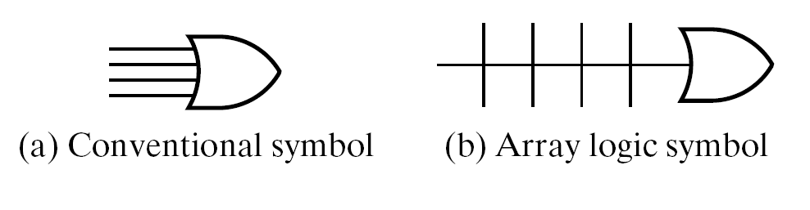
Wiring Conventions for Programmable Logic
We deal with a large number of gates and gate inputs
Need a more concise way of expressing gate circuits graphically
Inputs (literals)
A
A
B
B
1 wire
Output = ?
Inputs
X
X
X marks a connection, i.e. an input to the OR

Slide 69
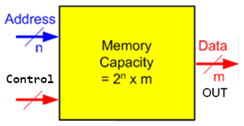
Read Only Memory (ROM)
Data stored in a ROM is non-volatile
Once written, this data is permanently stored until erased or changed through re-programming (if applicable)
The ROM has n input lines for the address and m output data lines
Total memory capacity of a ROM is 2^{n} x m bits
Generally, system-level programs that need to be accessed frequently and at power up access are stored in the computer’s ROM, e.g. the BIOS firmware

Slide 70
Programmable Logic Array (PLA)
Compared to a ROM and a PAL, a PLA is the most flexible having a programmable set of ANDs combined with a programmable set of ORs.
Advantages
A PLA can have large N and M permitting implementation of equations that are impractical for a ROM
A PLA has all of its product terms connectable to all outputs, overcoming the problem of the limited inputs to the PAL ORs
Some PLAs have outputs that can be complemented, adding POS functions
Disadvantage
Often, the product term count limits the application of a PLA.
Two-level multiple-output optimization reduces the number of product terms in an implementation, helping to fit it into a PLA.

Slide 71

Buffer/inverter
(a) Symbol. (b) Logic equivalent

Slide 72


Programmable Logic Array (PLA)
For each product term, the inputs are marked with 1, 0, or — (dash).
If a variable in the product term appears in the form in which it is true, the corresponding input variable is marked with a 1.
If it appears complemented, the corresponding input variable is marked with a 0.
If the variable is absent from the product term, it is marked with a dash.

Slide 73

Programmable Logic Array (PLA)
x exor 0=x
X exor 1=x’
PLA with three inputs, four product terms, and two outputs

Slide 74






Programmable Logic Array (PLA)
Example:
) (

Slide 75
Programmable Logic Array (PLA)
Implement the following Boolean function with a PLA:
Y1(A,B,C)=∑m(4, 5,7)
Y2(A,B,C)=∑m(3, 5,7)
x
x
x’
Step 1:
A | B | C | Y1 | Y2
0 | 0 | 0 | 0 | 0
0 | 0 | 1 | 0 | 0
0 | 1 | 0 | 0 | 0
0 | 1 | 1 | 0 | 1
1 | 0 | 0 | 1 | 0
1 | 0 | 1 | 1 | 1
1 | 1 | 0 | 0 | 0
1 | 1 | 1 | 1 | 1
Step 2: (Using K-map find minimal SOP )
Y1=AB’+AC
Y2=BC+AC
Step 3: Number of Buffer (=3)
Programmable AND gate =number of function (Y1 and Y2 )=2

Slide 76

Programmable Logic Array (PLA)
A
B
C
Y1=AB’+AC
Y2=BC+AC
Y1
Y2

Slide 77

Programmable Logic Array (PLA)
A 3×2 PLA with 4 product terms

Slide 78
Programmable Logic Array (PLA)
Implement the following functions using PLA
F₀ = A+B' C'
F₁ = A C' +A B
F₂ = B' C'+A B
F₃ = B' C+A

Slide 79
Programmable Logic Array (PLA)
Implement the following functions using PLA
Y₁ = ∑m(0, 1, 7)
Y₂ = ∑m(0, 3, 6, 7)
Y₃ = ∑m(0, 1, 3, 5, 7)

Slide 80
Programmable Logic Array (PLA)
Implement BCD to Gray Code Converter using PLA

Slide 81
Programmable Logic Array (PLA)
Implement the following functions using PLA
w(A, B, C, D) = ∑(2, 12, 13)
x(A, B, C, D) = ∑(7, 8, 9, 10, 11, 12, 13, 14, 15)
y(A, B, C, D) = ∑(0, 2, 3, 4, 5, 6, 7, 8, 10, 11, 15)
z(A, B, C, D) = ∑(1, 2, 8, 12, 13)
w = ABC’ + A’B’CD’
x = A + BCD
w = A’B + CD + B’D’
w = ABC’ + A’B’CD’ + AC’D’ + A’B’C’D = w + AC’D’ + A’B’C’D

Slide 82
Programmable Array Logic (PAL)
It is most commonly used type of PLD.
The PAL is a programmable logic device with a fixed OR array and a programmable AND array.
Only the AND gates are programmable, the PAL is easier to program than, but is not as flexible as, the PLA.
Figure (Next slide) shows the logic configuration of a typical PAL with four inputs and four outputs.

Slide 83

Programmable Array Logic (PAL)
INPUT
S
OUTPUTS

Slide 84
Programmable Array Logic (PAL)
Step 1 Make the truth table
Step2 Minimal SOP using k-map
X(A,B,C)= ∑m(2,3,5,7)=
Y(A,B,C)= ∑m(0,1,5)=
Z(A,B,C)= ∑m(0, 2,3,5)=
A
B
C
X
Y
Z

Slide 85
Programmable Array Logic (PAL)
X(A,B,C)= ∑m(2,3,5,7)=A’B+AC
Y(A,B,C)= ∑m(0,1,5)=A’B’+B’C
Z(A,B,C)= ∑m(0, 2,3,5)=A’B+A’C+AB’C
A
B
C
X
Y
Z

Slide 86
Programmable Array Logic (PAL)
X(A,B,C)= ∑m(2,3,5,7)=A’B+AC
Y(A,B,C)= ∑m(0,1,5)=A’B’+B’C
Z(A,B,C)= ∑m(0, 2,3,5)=A’B+A’C+AB’C
A
B
C
X
A’B
AC
A’B’
B’C
A’B
A’C
AB’C
X
Y
Z

Slide 87
Programmable Array Logic (PAL)
Implement the following Boolean function with a PAL:
Y1(A,B,C)=∑m(4, 5,7)
Y2(A,B,C)=∑m(3, 5,7)

Slide 88

Programmable Array Logic (PAL)
Implement the following Boolean function with a PAL:
W = AB′C′+CD
X = A′BC′+A′CD+ACD′+BCD
Y = A′C′D+ACD+A′BD
x
x
x
x

Slide 89
Programmable Array Logic (PAL)
Implement the following Boolean function with a PAL:
W = AB′C′+CD
X = A′BC′+A′CD+ACD′+BCD
Y = A′C′D+ACD+A′BD
x
x
x
x

Slide 90
THANKS

